Slide 1
Malaria Drugs
Spreadsheet Documentation

Slide 2
General Information
Link to spreadsheet: https://docs.google.com/a/binghamton.edu/spreadsheet/ccc?key=0Ag8gS12PpxX2dF82NS1CLVhwd1RDSjhiMnFpdGtUZVE&usp=drive_web#gid=1
Spreadsheet contains data regarding
Summary of company rankings
WHO groupings and country categorizations
The burden of Malaria and the data of its drugs by countries
The burden of TB and the data of its drugs by countries
The burden of HIV and the data of its drugs by countries

Slide 3
Tab (1) Summary of Company Rankings
List of pharmaceutical companies, their drugs and target diseases
Ranking of the companies’ total impact scores:
Total impact scores = Need (DALYs lost) * Access (Treatment coverage) * Efficacy
Ranking of the companies break down by diseases
Total DALYs alleviated in different diseases break down by WHO regions

Slide 4
Tab (2) Country Data
Lists all countries and various ways countries are categorized:
Geographical region
UNAIDS region
UNICEF region
WHO region
World Bank Economy ranking

Slide 5
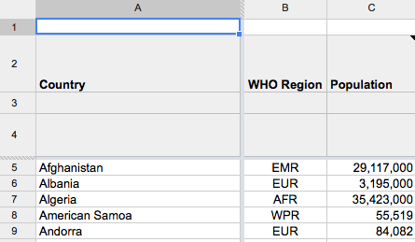
Tab (3) Malaria by Countries
General information
Column A: List of countries
Column B: Countries sorted by WHO regions
Column C: Population

Slide 6
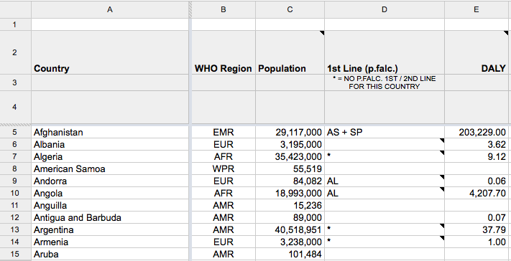
Tab (3) Malaria by Countries
Column D: Which first line drugs are used in the country for Plasmodium falciparum (p. falc.) malaria
Column E: DALYs lost to malaria break down by country (2010 data)

Slide 7
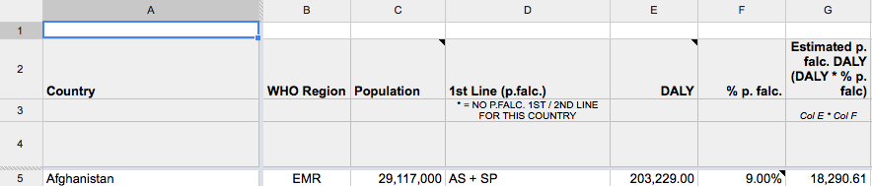
Calculating Needs
Column F: % of p. falc. (WHO 2011 data)
Column G: Estimated need of p. falc. DALYs = DALYs lost (E) * % of p. falc. (F)
E * F = G

Slide 8
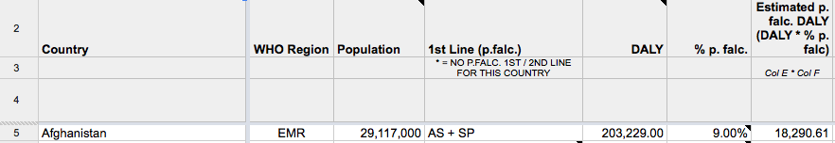
Example Calculating Need in Afghanistan
Afghanistan (row 5) is using AS + AP to treat its p. falc. Malaria.
The DALYs lost to malaria in Afghanistan in 2010: 203,229.00
% p. falc. = 9.00%
Estimated DALYs lost to p. falc. Malaria in 2010 in Afghanistan = 203,229.00 * 9% = 18,290.61
The Estimated Need in Afghanistan: 18,290.61

Slide 9
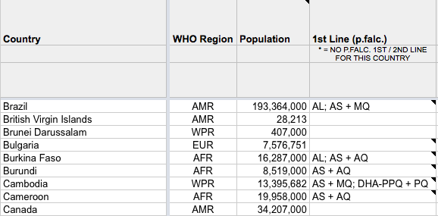
Calculating Needs II
If a country is using multiple p. falc. first- or second-line treatments, we divide the estimated p. falc. DALYs by the number of treatments and assign the divided DALYs to each treatment

Slide 10
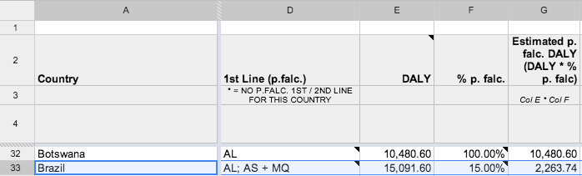
Example: Brazil
Brazil (row 33) is using both AL and AS + MQ to treat its p. falc. Malaria
DALYs lost to Malaria in Brazil in 2010: 15,091.60
% p. falc: 15%
Estimated p. falc. DALYs = 15091.60 * 15% = 2,263.74
Estimated p. falc. DALYs treatable by AL and AS+MQ = 2263.74/2 = 1,131.87 each
AL and AS+MQ each has an estimated need of 1,131.87 DALYs

Slide 11
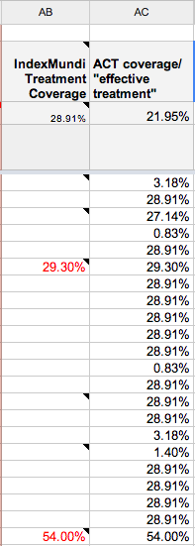
Calculating Access
Column AC:
ACT coverage/effective treatment
Column AB: Country-specific survey data, if the data is available.
1.
or
Regional average: the average of the available survey data in column AB for each region as defined in column B, if the data is not available.
2.
or
Global average: the average of all available survey data in column AB, if no regional survey data on treatment coverage is available .
3.

Slide 12
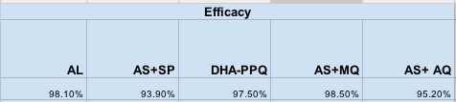
Calculating Efficacy
Column R to V: Efficacy breakdown by country (WHO 2010 data)
If a treatment efficacy is unavailable within a country, we use the average treatment efficacy of the drug in all countries where data is available.

Slide 13
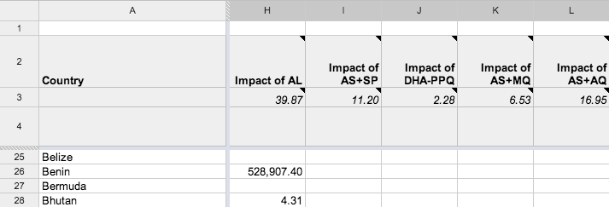
Calculating Impact
Columns H-L: For each country, the impacts of its listed first- and second-line drugs are calculated by the Need (Column G divided by number of listed drugs) * Access (column AC) * Efficacy (columns R-V)

Slide 14
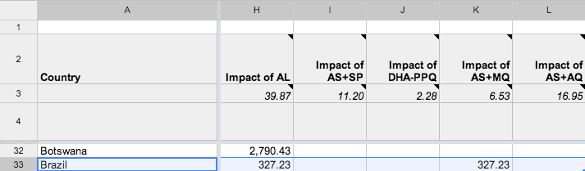
Example: Brazil
Since there are two drugs used in Brazil, each has its need multiplied by the country-specific access and drug-specific efficacy:
AL: 1,131.87 DALYs * 28.91% * 100% = 327.23 DALYs averted by AL
AS+MQ: 1,131.87 DALYs * 28.91% * 100% = 327.23 DALYs averted by AS+MQ

Slide 15
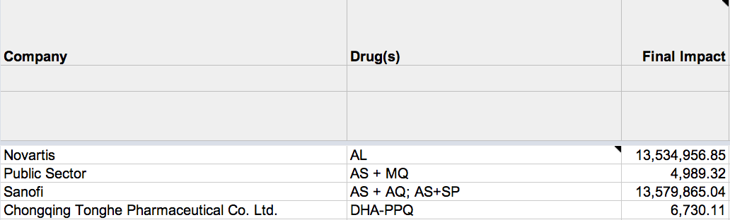
Impact Score by Companies
Cells M5 to N8: Companies and their drugs
A company’s final impact score for Malaria = DALYs * treatment coverage * efficacy for each drug it produces in each country that these drugs are used in.

